Slide 1
RNA-seq analysis is easy as 1-2-3 with
WEHI Masterclass 2021
24 Aug 2021
Instructor: Xueyi Dong

Slide 2
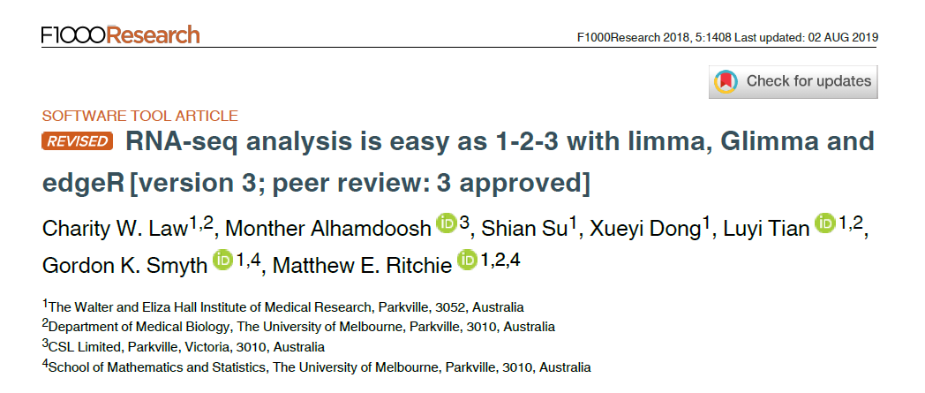
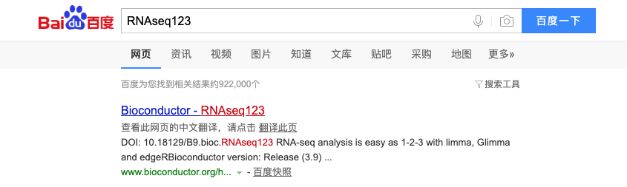

Slide 3
使用RStudio云服务器
访问 http://workshop.bioc.cancerdatasci.org/
下拉菜单选择RNA-seq 123 (Chinese)，并填写你的邮箱地址，点击“submit”
点击“Launch Workshop”，进入Rstudio登录界面
用户名: rstudio
密码: welcome-to-bioc2020

Slide 4
Use Orchestra platform
Visit this Orchestra http://app.orchestra.cancerdatasci.org/. platform (Some participants may need to use a VPN to connect to the Orchestra platform.)
Sign in using your email address and set a password.
From the ‘Choose a workshop’ page, search “WEHI” to find the Masterclass teaching materials for each day.
Select the “Launch” button to access your very own RStudio server instance in the cloud which comes with all the required software and data for the workshop.

Slide 5
If you can’t use Orchestra platform
Follow the instruction on https://xueyidong.github.io/RNAseq123workshop/ to install the R packages or use the Docker image

Slide 6
Introduction
RNA-sequencing is a method to quantify the amount of RNA in a sample
Tells us which genes are active and how much they are transcribed
Measure gene expression levels
Differential expression analysis
Compare gene expression between different groups
Examples:
Compare normal cells to mutated cells
Compare treated cells to control cells

Slide 7
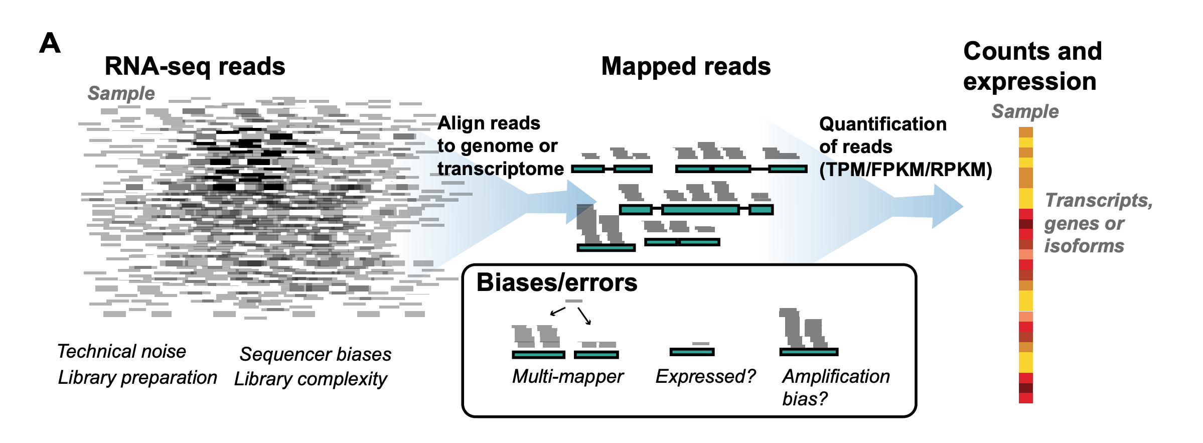
Alignment and counting
Ballouz et al, NAR 2018
Notes:
https://www.ncbi.nlm.nih.gov/pmc/articles/PMC6007662/

Slide 8



RNA-seq overview
Sequence reads – FASTQ files
Align to reference genome
Count number of reads mapped to each gene (counts matrix)
Data pre-processing
Differential expression analysis
Notes:
Can be replaced by schematic

Slide 9
Experimental design
Biological replicates!
Reference samples between different sequencing runs (if adding MORE samples and want to analyse together)
Don’t sequence all of one group on one day, and all of another group on another day! Group will be confounded with sequencing date.
Likewise for any other potential batch effects – sampling date, sequencing date, technician collecting/preparing samples.
Notes:
Credit: Charity Law

Slide 10
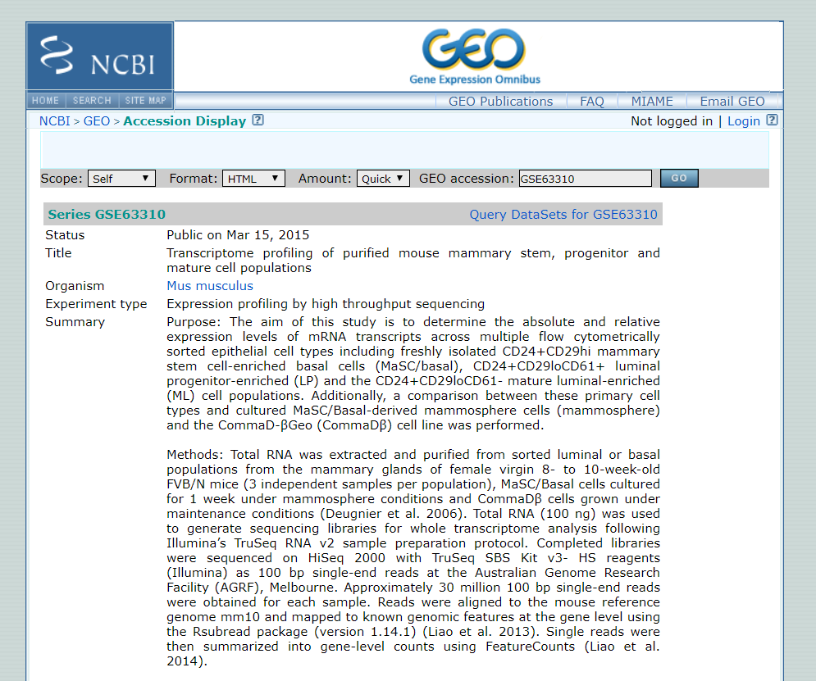
About the data
Sheridan et al. (2015)
Mouse mammary glands samples from 3 cell populations:
Basal 3 replicates
Luminal progenitor (LP) 3 replicates
Mature luminal (ML) 3 replicates
Want to compare gene expression levels between cell populations

Slide 11
Getting started
[Demo in R]
Notes:
Open Rstudio
Point out the four panes in Rstudio and mention what they are.
File > New File > R script

Slide 12
Data visualisation: MDS plots
MDS plot = Multidimensional scaling plot
Fold change = ratio between two values
Looks at where the greatest sources of variation in the data come from
Distances represents the typical log2-fold change observed between each pair of samples
e.g. 6 units apart = 2^6 = 64-fold difference
Unsupervised clustering – separation based on data, no prior knowledge of experimental design.
Useful for an overview of the data. Do samples separate by experimental groups?
Quality control
Outliers?
Notes:
Adapted from Charity’s slide.
The distance between each pair of samples (columns) is the root-mean-square deviation (Euclidean distance) for the top 500 genes. Distances on the plot can be interpreted as leading log2-fold-change, meaning the typical (root-mean-square) log2-fold-change between the samples for the genes that distinguish those samples.

Slide 13
Differential expression analysis

Slide 14
limma and linear modelling
linear modelling for microarrays (and RNAseq)
Effects are estimated for parameters specified by the design matrix e.g. Condition1 and Condition2
The expressions of each gene is different but, the same model is fitted to tens of thousands of genes simultaneously.
Mean expression of Gene X
9
3
Notes:
Credit: Charity Law

Slide 15
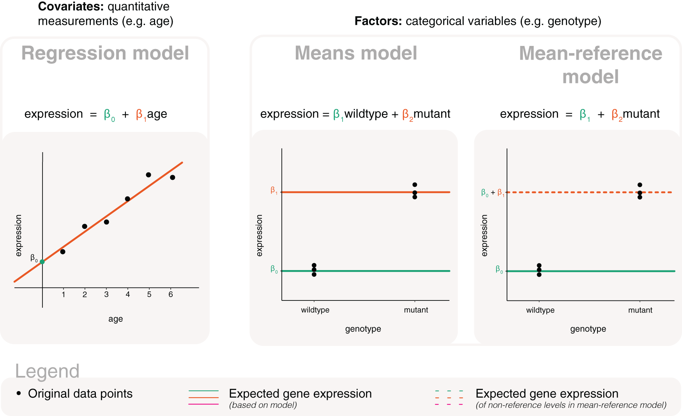
Basic models
parameters
Law CW et al. A guide to creating design matrices for gene expression experiments [version 1]. F1000Research 2020, 9:1444 (doi: 10.12688/f1000research.27893.1)
Notes:
LEFT: β₀ the y-intercept, and β₁ the slope
CENTER: β₁ represents the mean expression for wildtype and β₂ represents the mean of mutant.
RIGHT: β₁ represents the mean expression for wildtype and β₂ represents the difference between mutant and wildtype.

Slide 16
Accounting for factors that are not of interest
E.g. samples from two groups (wildtype, mutant) are sequenced in two batches (batch1 and batch2)
expression=β₁wildtype+β₂mutant+ β₃batch2
or
expression=β₁+β₂mutant+ β₃batch2
Quiz: write out an appropriate model for our dataset :
3 cell populations: Basal, LP, ML
sequenced in 3 lanes: lane004, lane006, lane008
expression=β₁Basal+β₂LP+ β₃ML+β₄lane006+ β₅lane008
or expression=β₁+β₂LP+ β₃ML+β₄lane006+ β₅lane008
Law CW et al. A guide to creating design matrices for gene expression experiments [version 1]. F1000Research 2020, 9:1444 (doi: 10.12688/f1000research.27893.1)
Notes:
LEFT: β₀ the y-intercept, and β₁ the slope
CENTER: β₁ represents the mean expression for wildtype and β₂ represents the mean of mutant.
RIGHT: β₁ represents the mean expression for wildtype and β₂ represents the difference between mutant and wildtype.

Slide 17
limma and linear modelling
The design matrix is used to specify independent variables that have an influence on gene expression
e.g. experimental group, batch effects
Design matrix can be specified with or without intercept
Will focus on intercept-free design matrix here
Examples on various design matrices are available in the limma users guide

Slide 18
limma and linear modelling
Contrasts are used to find differences between the effects.
The variability in the observations determines whether the difference is considered “significant” or not (?p-value<0.05)
Mean expression of Gene X
6
9
3
Notes:
Credit: Charity Law

Slide 19
limma and linear modelling
Contrasts are used to find differences between the effects.
Variability in the observations determines whether the difference is considered significant or not (p-value<0.05?)
Sample expression of Gene X
6
9
3
Notes:
Credit: Charity Law

Slide 20
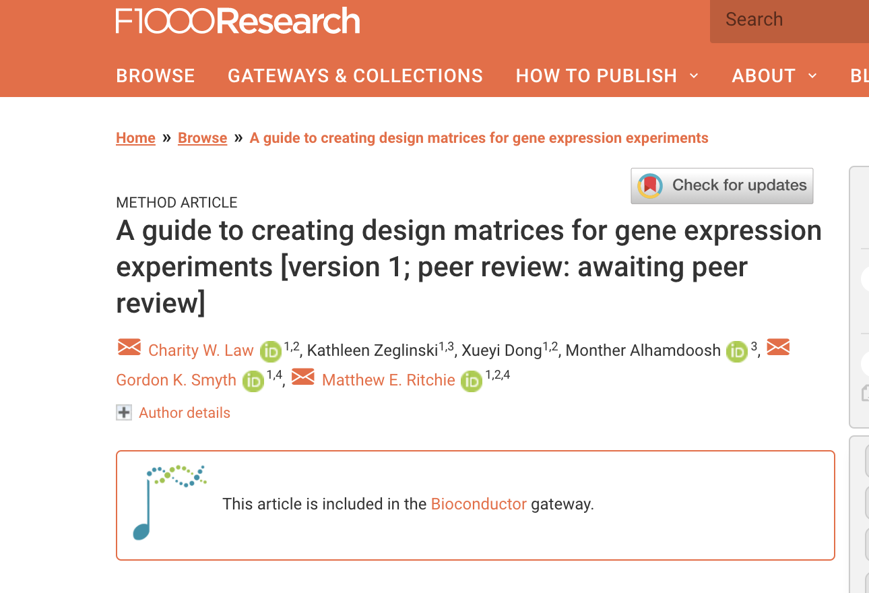
Design matrices and contrasts guide
http://bit.ly/3atkFXx

Slide 21
Batch effects in intercept-free model

Slide 22
RNA-seq data is
discrete (counts)
has non-constant mean-variance trend
voom
Transform to log-counts per million
Remove mean-var dependence through the use of precision weights
✔
Appropriate to assume Normality
continuous
has constant variance
Notes:
Credit: Charity Law
Let me show you what the mean-var dependence looks like …

Slide 23
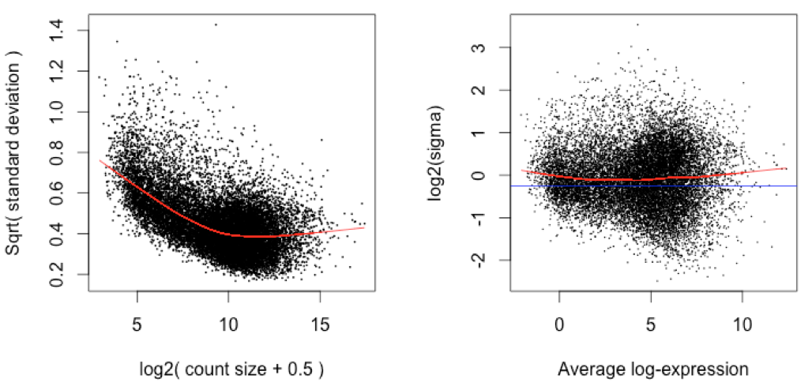
voom: variance weights
Use mean-var trend to assign weights to each observation
Weights used in linear modelling removes mean-variance trend from the data.
Before: trended variance
After: constant variance
Qtr-root variance
Log2- variance
Mean log-count
Mean log-cpm
Notes:
Credit: Charity Law

Slide 24
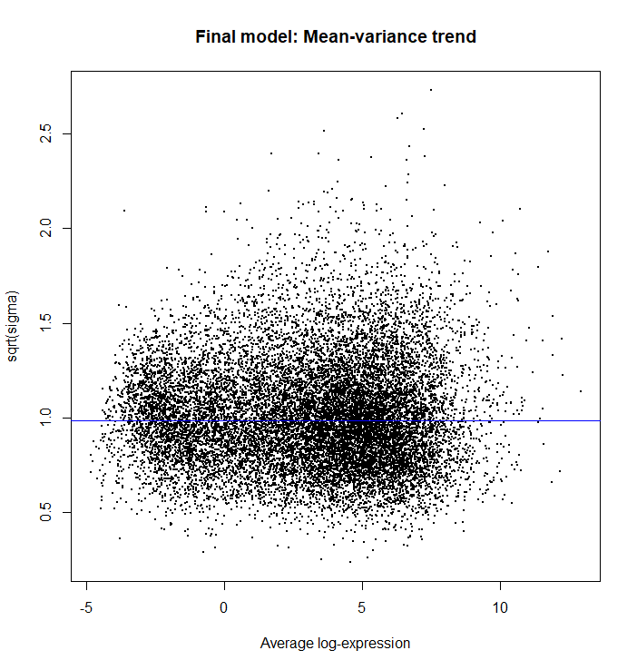
Fit linear models
Fits a linear model for each gene
Computes statistics and fold changes for comparisons of interest
> vfit <- lmFit(v, design)
> vfit <- contrasts.fit(vfit, contrasts=contr.matrix)
> efit <- eBayes(vfit)
> plotSA(efit, main="Final model: Mean-variance trend")
Computes more precise estimates by sharing gene information using empirical Bayes moderation
Plots residual standard deviation versus average log expression for fitted model

Slide 25
Sharing gene information
Experiments have small sample sizes due to sequencing cost and/or availability of samples and RNA.
Estimated variability within an individual gene is unreliable (statistically inefficient) $→$ pooling information from all genes (increases statistical power)
Empirical Bayes method: borrow information from all data to form prior information that is used to adjust observed values to values that are more precise.
In limma, a posterior variance is calculated by squeezing observed variances towards the prior variance. The posterior variance is given by
Moderated t-statistic is calculated using the posterior variance.
$$S2g=\frac{d0s20+dgs2g}{d0+dg}$$
Notes:
Credit: Charity Law
$s20$ is the prior variance
$s2g$ is the observed variance

Slide 26
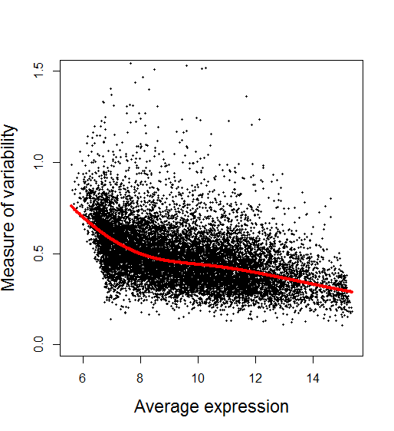
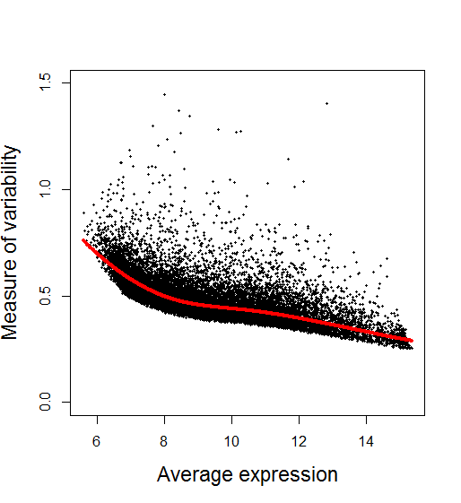
Variability before and after empirical Bayes adjustment
Before After
Slide from COMBINE workshop (edited)
Notes:
Credit: Charity Law

